Slide 1
Chapter 7 Supervised Learning Methods: Part 1
Supervised Learning is the task of learning to predict a numerical or a categorical output for a given input sample.
An explanation of Linear Regression followed by a scikitlearn based experiment.
Discuss a few measures to determine the quality of regression model.
Logistic Regression learns a simple model and visualize its predictions in a decision boundary chart.
Decision Trees forms the basis of a powerful suite of methods that are used for both classification and regression.

Slide 2
Linear Regression
Linear regression is a supervised learning method specifically to model the relationship between a dependent variable and one or more independent variables.
This is an attempt to construct a linear function that outputs the value.

Slide 3
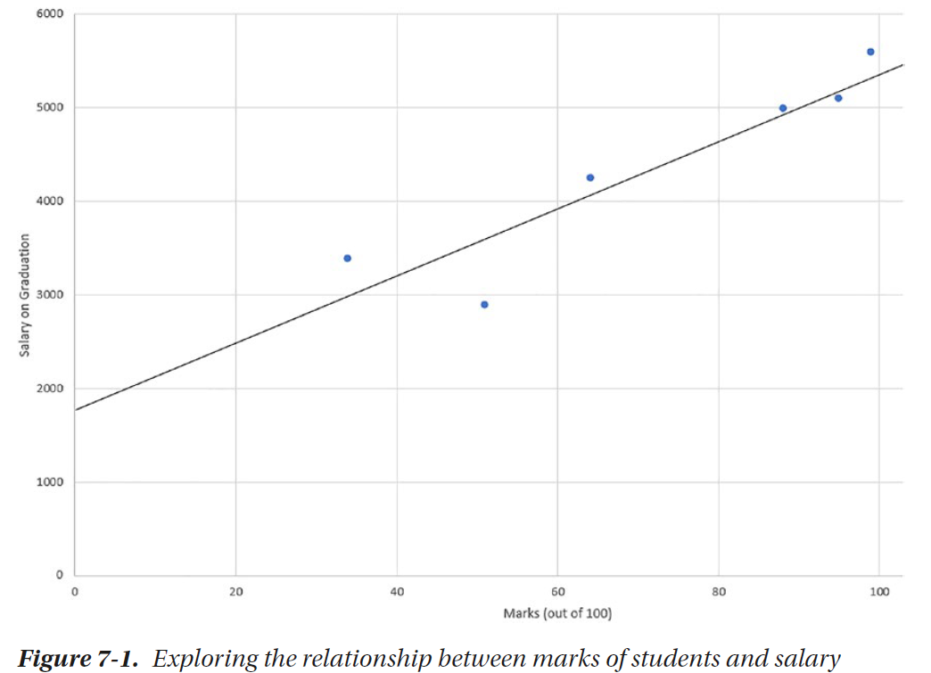
By a simple look, you can visualize the linear relationship between the two despite several outliers. We attempt to find the line that best justifies all the points of the dataset as a whole.

Slide 4
Finding the Regression Line

Slide 5
It is true that due to the nature of real-world data, no line can go through all the points. This leads to the notion of error.
Error is defined as the difference between the independent variable’s actual value and the value determined by our regression line. We wish to find the slope m, and y intercept c such that the total cost, given by the average value of squared of the errors.

Slide 6
Usually, the data will have more than one column (components of x) that will be referred as x₁, x₂, x₃… x_{n}, which will lead to a line that has slopes of m₁, m₂, m₃… m_{n} across the n axes. Thus, the number of parameters you learn will be (n + 1) where n is the number of columns, or dimensions of the data.

Slide 7
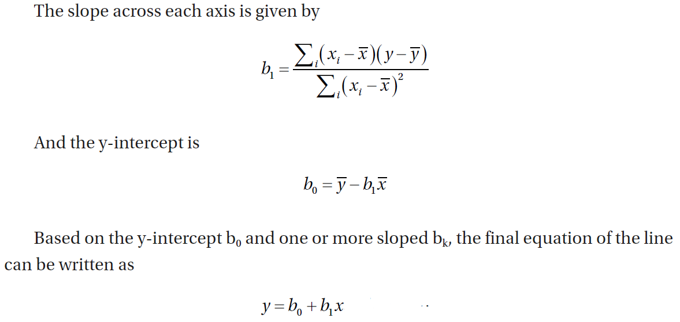
For simplicity, we will continue the explanation for a case where you have only one independent column, x.

Slide 8
Linear Regression Using Python
Scikit-learn provides an easy-to-use interface for ordinary least squares implementation.
We’ll create a Pandas dataframe that contains two columns: an independent variable, which mentions marks of a student out of 100, and a dependent variable, which is the salary they get after graduation.
We want to create a linear model that expresses the relationship between the two.
We will thus be able to predict the salary a student will get based on the marks they obtained.

Slide 9
import numpy as np
import pandas as pd
data = pd.DataFrame({"marks":[34,95,64,88,99,51], "salary":[3000, 9800,
6600, 8400, 9700, 5400]})
# Transform Data
X = data[['marks']].values
Y = data['salary'].values
# Learn to Establish the Model
from sklearn.linear_model import LinearRegression
reg = LinearRegression()
reg.fit(X,Y)
# Predict
print(reg.predict([[70]]))
print(reg.predict([[100],[50],[80]]))

Slide 10
Visualizing What We Learned
print (reg.coef_)
print (reg.intercept_)
import matplotlib.pyplot as plt
fig,ax = plt.subplots()
plt.scatter(X, Y)
ax.axline( (0, reg.intercept_), slope=reg.coef_ , label='regression line')
ax.legend()
plt.show()

Slide 11
Evaluating Linear Regression
We have several evaluation measures to check how well our regression model is performing. In this example, we will simply compare how far our predictions are with respect to the actual values in the training dataset.

Slide 12
results_table = pd.DataFrame(data=X, columns=['Marks'])
results_table['Predicted Salary'] = reg.predict(X)
results_table['Actual Salary'] = Y
results_table['Error'] = results_table['Actual Salary']-results_table['Predicted Salary']
results_table['Error Squared'] = results_table['Error']* results_table['Error']
print(results_table)

Slide 13
We can use this table to compute the mean absolute error or mean squared error, or most commonly root mean squared error.
import math
import numpy as np
mean_absolute_error = np.abs(results_table['Error']).mean()
mean_squared_error = results_table['Error Squared'].mean()
root_mean_squared_error = math.sqrt(mean_squared_error)
print (mean_absolute_error)
print (mean_squared_error)
print (root_mean_squared_error)

Slide 14
Alternatively, you can use internal implementations to achieve the same error values.
from sklearn.metrics import mean_squared_error, mean_absolute_error
print(mean_squared_error(results_table['Actual Salary'], results_table['Predicted Salary']))
print(math.sqrt(mean_squared_error(results_table['Actual Salary'], results_table['Predicted Salary'])))
print(mean_absolute_error(results_table['Actual Salary'], results_table['Predicted Salary']))

Slide 15
Scikit-learn also provides R Squared value that measures how much variability in a dependent variable can be explained by the model.
R Squared is a popularly used measure of goodness of fit of a linear regression measure.
Mathematically, it is 1 – sum of squared of prediction error divided by the total sum of squares.
It’s value is usually between 0 and 1, with 1 representing the ideally best possible model

Slide 16
from sklearn.metrics import r2_score
print ("R Squared: %.2f" % r2_score(Y, reg.predict(X)))

Slide 17
Logistic Regression
Logistic regression is a classification method that models the probability of a data item belonging to one of the two categories.
In the following graph, we wish to predict whether a student will get a job or not based on the marks they obtained in machine learning and in data structures.
We want to create a boundary line that separates the students based on their marks on the two subjects so that those who got a job offer by the time they graduated belong to one side of the line and those who didn’t on the other side.

Slide 19
We want to create a boundary line that separates the students based on their marks on the two subjects so that those who got a job offer by the time they graduated belong to one side of the line and those who didn’t on the other side.
A potential boundary line is shown in Figure 7-4. Thus, when you get information about a new data point in terms of marks scored in the two subjects, we will be able to predict whether they will get a job or not.

Slide 20
This classification technique is called logistic regression, though it is used to predict binary categorical variables, not continuous like regression methods do.
Its name contains the word “regression” because of old conventions as here we try to learn the parameters to regress the probability of a data point belonging to a categorical class.

Slide 21
Line vs. Curve for Expression Probability
Assume that we have a data in only one dimension (say, average marks) and there are two class labels referring to those who got a job and those who didn’t.
We will call them as positive and negative classes in this discussion. We can try to capture this relationship to find a linear regression line that gives us a probability of a point belonging to a certain class.

Slide 22
However, the target values in the training data are either 0 or 1, where 0 represents the negative class and 1 represents the positive class.
However, this kind of data will be hard to capture through a linear relationship.
We rather prefer to find a sigmoid or logistic curve that tries to capture the pattern in which most of the predicted values will lie on either y=0 or y=1, and there will be some values within this range.
This dependent value can also be treated as the probability for the point to belong to one of the classes.

Slide 23
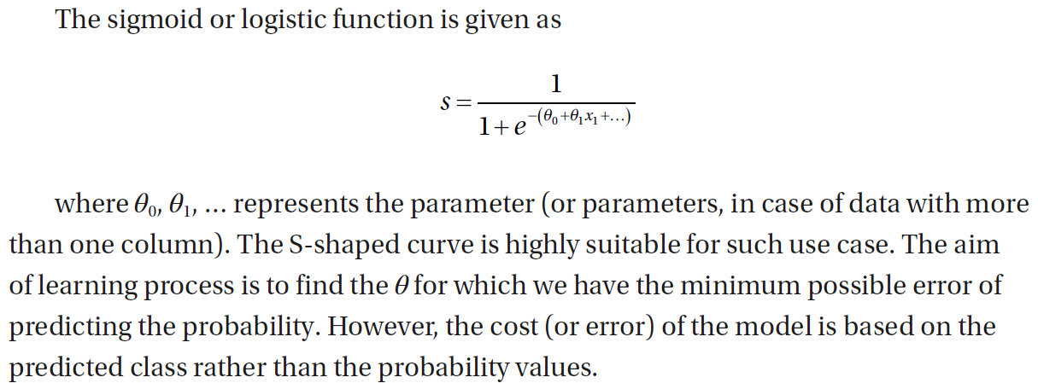

Slide 24
Learning the Parameters
We use a simple iterative method to learn the parameters.
Any shift in the values of the parameters causes a shift in the linear decision boundary.
We begin with random initial values of the parameters, and by observing the error, we update the parameters to slightly reduce the error.
This method is called gradient descent.
Here, we try to use the gradient of the cost function to move to the minimum possible cost.

Slide 25
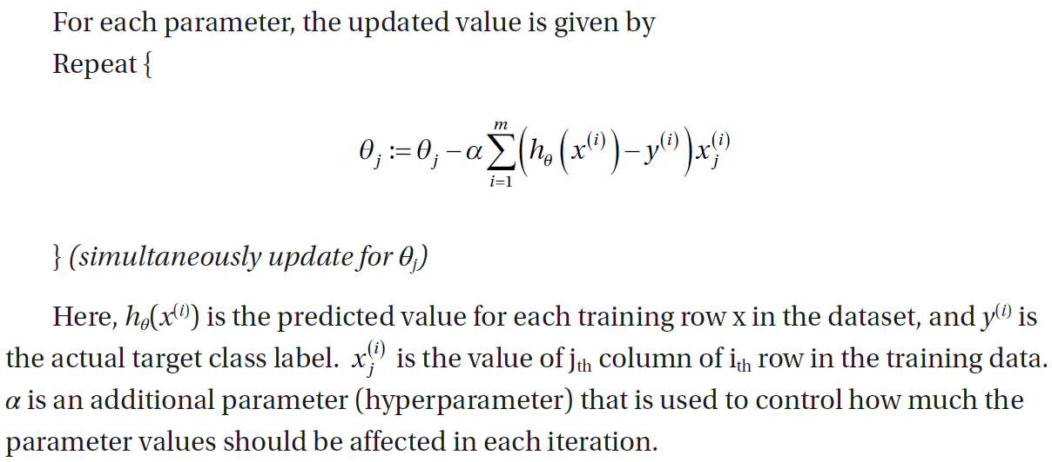

Slide 26
Logistic Regression Using Python
In this example, we will revisit the iris dataset.
This dataset contains 150 rows containing sepal length, sepal width, petal length, and petal width of each flower.
Based on the sepal and petal dimensions, we want to be able to predict whether a given flower is Iris Setosa, Iris Versicolor, or Iris Virginica.

Slide 27
Let’s prepare the dataset using internal datasets provided with Scikit-learn.
from sklearn import datasets
iris = datasets.load_iris()
print(iris)
load_iris() method returns a dictionary containing the following columns: dict_keys(['data', 'target', 'frame', 'target_names', 'DESCR', 'feature_names', 'filename'])

Slide 28
We can prepare the data for our purpose using the values of these keys. Although we need the raw numbers for training a logistic regression model using Scikit-learn, we will prepare the full dataframe to observe the complete structure of the data in this example.
from sklearn import datasets
iris = datasets.load_iris()
import pandas as pd
iris_data = pd.DataFrame(iris['data'], columns=iris['feature_names'])
iris_data['target'] = iris['target']
iris_data['target'] = iris_data['target'].apply( lambda x:iris['target_names'][x] )
print(iris_data)

Slide 29
Before we continue this experiment, we will deliberately pick data from Iris Setosa and Iris Versicolor categories to simplify the dataset to be able to fit a binary classification model. There are three types – we will take only two.
df = iris_data.query("target=='setosa' | target=='versicolor'")
Let’s first have a look at the data. There are four variables. Let’s pick petal width and length to plot the 100 flowers in 2D.
import matplotlib.pyplot as plt
import seaborn as sns
sns.FacetGrid(df, hue='target', size=5).map(plt.scatter, "petal length (cm)", "petal width (cm)").add_legend()

Slide 30
from sklearn import datasets
iris = datasets.load_iris()
import pandas as pd
iris_data = pd.DataFrame(iris['data'], columns=iris['feature_names'])
iris_data['target'] = iris['target']
iris_data['target'] = iris_data['target'].apply( lambda x:iris['target_names'][x] )
df = iris_data.query("target=='setosa' | target=='versicolor'")
import matplotlib.pyplot as plt
import seaborn as sns
sns.FacetGrid(df, hue='target', height=5).map(plt.scatter, "petal length (cm)", "petal width (cm)").add_legend()

Slide 31
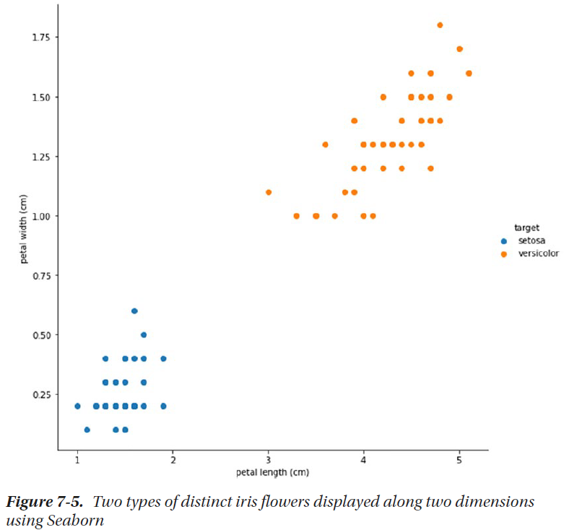

Slide 32
Let’s create a logistic regression model using Scikit-learn.
from sklearn.linear_model import LogisticRegression
logistic_regression = LogisticRegression()
X = iris_data.drop(columns=['target'])
y = iris_data['target']
logistic_regression.fit(X,y)
X_test = [[5.6, 2.4, 3.8, 1.2]]
logistic_regression.predict(X_test)

Slide 33
Visualizing the Decision Boundary
To understand how the learned model splits the data into two classes, we will recreate the model using only two dimensions and plot a 2D chart based on sepal length and sepal width. We are limiting the dimensions for easy visualization and understandability.
df = iris_data.query("target=='setosa' | target=='versicolor'")[['sepal length (cm)','sepal width (cm)','target']]
X = df.drop(columns=['target']).values
y = df['target'].values
y = [1 if x == 'setosa' else 0 for x in y]
from sklearn.linear_model import LogisticRegression
logistic_regression = LogisticRegression()
logistic_regression.fit(X,y)

Slide 34
Once we have learned the parameters, we will take every possible point in this 2D space, say, (3.0,3.0), (3,3.1), (3,3.2)…, (3.1,3.0), (3.1,3.1), (3.1,3.2)…, and so on. We will predict the probable class of every such point, and based on the predictions, we will color the point. Eventually, we should be able to see the whole 2D space divided into these two colors, where one color represents Iris Setosa and the other color represents Iris Versicolor.

Slide 35
x_min, x_max = X[:, 0].min()-1, X[:,0].max()+1
y_min, y_max = X[:, 1].min()-1, X[:,1].max()+1
import numpy as np
xx, yy = np.meshgrid(np.arange(x_min, x_max, 0.02), np.arange(y_min,y_max, 0.02))
Z = logistic_regression.predict(np.c_[xx.ravel(), yy.ravel()]).reshape(xx.shape)
plt.rcParams['figure.figsize']=(10,10)
plt.figure()
plt.contourf(xx, yy, Z, alpha=0.4)
plt.scatter(X[:,0], X[:,1], c=y, cmap='Blues')
plt.xlim(xx.min(), xx.max())
plt.ylim(yy.min(), yy.max())

Slide 36
from sklearn import datasets
iris = datasets.load_iris()
import pandas as pd
iris_data = pd.DataFrame(iris['data'], columns=iris['feature_names'])
iris_data['target'] = iris['target']
iris_data['target'] = iris_data['target'].apply( lambda x:iris['target_names'][x] )
df = iris_data.query("target=='setosa' | target=='versicolor'")
import matplotlib.pyplot as plt
import seaborn as sns
sns.FacetGrid(df, hue='target', height=5).map(plt.scatter, "petal length (cm)", "petal width (cm)").add_legend()
df = iris_data.query("target=='setosa' | target=='versicolor'")[['sepal length (cm)','sepal width (cm)','target']]
X = df.drop(columns=['target']).values
y = df['target'].values
y = [1 if x == 'setosa' else 0 for x in y]
from sklearn.linear_model import LogisticRegression
logistic_regression = LogisticRegression()
logistic_regression.fit(X,y)
x_min, x_max = X[:, 0].min()-1, X[:,0].max()+1
y_min, y_max = X[:, 1].min()-1, X[:,1].max()+1
import numpy as np
xx, yy = np.meshgrid(np.arange(x_min, x_max, 0.02), np.arange(y_min,y_max, 0.02))
Z = logistic_regression.predict(np.c_[xx.ravel(), yy.ravel()]).reshape(xx.shape)
plt.rcParams['figure.figsize']=(10,10)
plt.figure()
plt.contourf(xx, yy, Z, alpha=0.4)
plt.scatter(X[:,0], X[:,1], c=y, cmap='Blues')
plt.xlim(xx.min(), xx.max())
plt.ylim(yy.min(), yy.max())

Slide 37
Decision Trees
Decision trees is an effective and highly interpretable suite of machine learning methods that generate a set of rules for regression or classification in the form of a set of decision rules that can be written down in a flowchart-like manner.

Slide 38
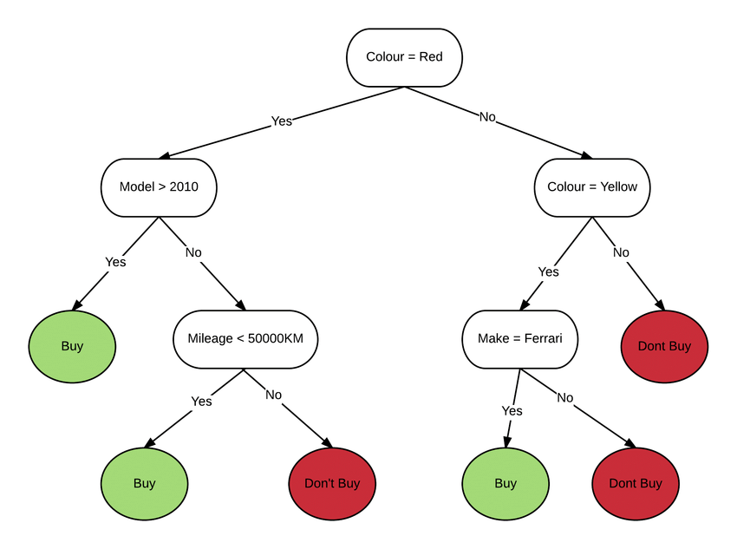

Slide 39
A decision tree is drawn upside down with its root at the top. Starting from the root, the tree is full of conditional statements; based on the results of such conditional statements one after the other, you the flow of control will be led down to the leaf nodes, the ones at the end, which denote the target class that is finally predicted.
Each data sample goes through a sequence of such tests till it reaches the leaves of the tree, which tree determine the class label based on the proportion of training data samples that fall on them.

Slide 40
Building a Decision Tree
The learning phase of a decision tree algorithm is a recursive process.
Within each recursion, it looks at the training data provided for the particular stage and tries to find the best possible split.
If there’s enough data with enough variation of target classes that can be split leading to a cleaner division of the target labels in the next stage, we proceed with the split.
Otherwise, if the training data that’s provided to the current stage is too small or belongs to the same target class, we consider it as a leaf node and assign the label of the majority class in the given dataset.

Slide 41
Picking the Splitting Attribute
Picking the one attribute based on which we can split and create a condition thus becomes the core of the algorithm.
There are several splitting criterions based on which several implementations are distinguished.
One such interesting criterion is to use the concept of entropy, which measures the amount of randomness or uncertainty in the data.

Slide 43
In a decision tree, we want to create the leaf nodes about which we are certain about the class label; thus, we need to minimize the randomness and maximize the reduction of entropy after the split. The attribute we select should lead to the best possible reduction of entropy.
This is captured by the quantity called information gain, which measures how much measure a feature gives us about the class. We thus want to select the attribute that leads to the highest possible information gain.

Slide 45
Decision Tree in Python
In this example, we will use the full Iris dataset that contains information about 150 Iris flower samples across the three categories.
import pandas as pd
from sklearn import datasets
iris = datasets.load_iris()
iris_data = pd.DataFrame(iris['data'], columns=iris['feature_names'])
iris_data['target'] = iris['target']
iris_data['target'] = iris_data['target'].apply( lambda x:iris['target_names'][x] )
print(iris_data.shape)

Slide 46
Let’s separate the features that we will use to learn the decision trees and the associated class labels.
X = iris_data[['sepal length (cm)', 'sepal width (cm)', 'petal length (cm)','petal width (cm)']]
y = iris_data['target']

Slide 47
We will then separate data into training and testing dataset.
from sklearn.model_selection import train_test_split
X_train, X_test, y_train, y_test = train_test_split (X,y,test_size=0.20,random_state=0)
This will separate the data into 80% training data and 20% testing data. We will thus create the decision trees based on approximately 120 rows (X_train and y_train) thus created. After that, we will predict the results for approximately 30 test data rows (X_test) and compare the predictions with actual class labels (y_test).

Slide 48
In the following lines, we initialize a decision tree classifier that uses Gini as the splitting criteria and builds trees up to a maximum depth of 4.
from sklearn.tree import DecisionTreeClassifier
DT_model = DecisionTreeClassifier(criterion='gini', max_depth=4)
DT_model.fit(X_train, y_train)
y_pred = DT_model.predict(X_test)
print(y_pred)

Slide 49
We can evaluate the performance of decision tree by comparing the predicted results with the actual class labels. Accuracy compares what ratio of y_pred is exactly the same as y_test. This should output a number from 0 to 1, with 1 representing 100% accurate results.
from sklearn.metrics import accuracy_score
print (accuracy_score(y_test, y_pred))
Confusion matrix shows the cross-tabulated count of actual labels and predicted labels.
from sklearn.metrics import confusion_matrix
confusion_matrix(y_test, y_pred)

Slide 50
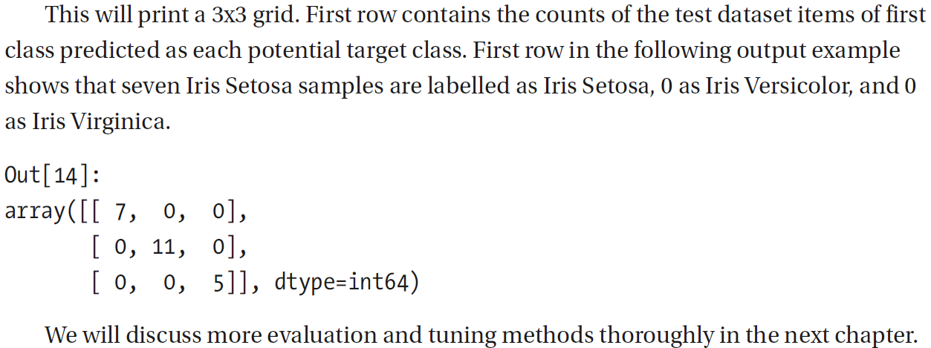

Slide 51
Pruning the Trees
Decision trees can be made more efficient using pruning, i.e., removing the branches that make the features having low importance. We can assign predefined hyperparameters to perform pruning using the operations like limit the depth of the decision trees, minimum samples that must be present to split an internal node, and minimum samples each leaf should contain.

Slide 52
Interpreting Decision Trees
One of the qualities of decision trees is that they are easy to understand, interpret, and visualize. If you can view how the decision conditions are arranged and how is the final label assigned, you can easily understand the underlying pattern of the data and the model that has been generated.

Slide 53
Scikit-learn provides an option to export a decision tree in DOT format, which is a popular format to store and share information about the structure and visual properties of graphs or trees. We can use that in conjunction with another library called PyDotPlus that will allow us to create the graph from DOT data. We can alternatively use DOT utility directly to visualize or export the graphs.

Slide 54
To view the trees directly in the Jupyter Notebook, we will also need Graphviz, which is an open source graph visualization software. You may download and install1 the right distribution for your system. You will also need to install PyDotPlus and Python-Graphviz to extract the information about the decision trees and convert them into a format that can be displayed on Jupyter Notebook.
%pip install pydotplus
%pip install python-graphviz

Slide 55
Once you have a tree created, use the following code block to import required elements:
import IPython
from sklearn.tree import export_graphviz
import pydotplus
import matplotlib.pyplot as plt
dot_data = export_graphviz(DT_model, feature_names=iris['feature_names'])
graph = pydotplus.graph_from_dot_data(dot_data)
img = IPython.display.Image(graph.create_png())
display(img) #or IPython.display.display(img)

Slide 56
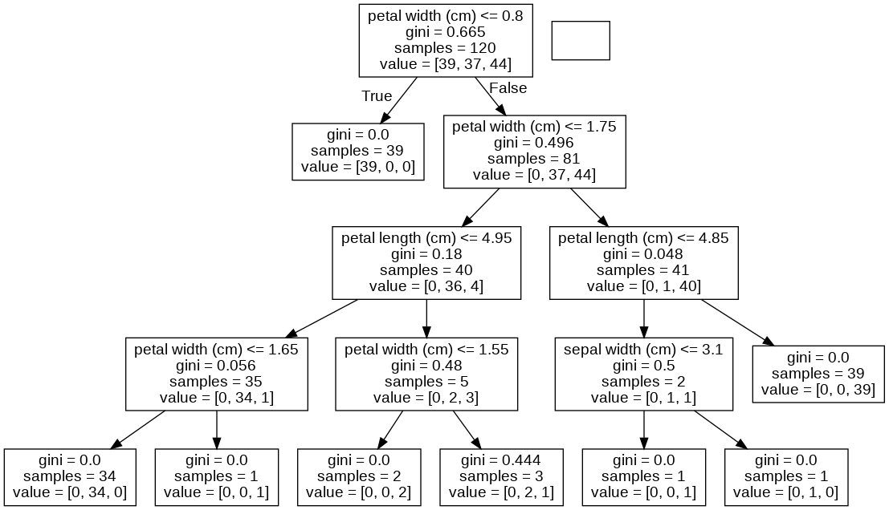

Slide 57
Each internal node of the tree shows a condition on one of the parameters, based on which we traverse either the right or the left subtree. The leaf node contains a value object that contains three elements. This shows how many training samples ending up on this leaf belong to each class. For example, the leftmost leaf contains value = [0,36,0], which means 36 training samples belong to Iris Versicolor, and none belong to either Iris Setosa or Iris Virginica. Thus, if any sample ends up on this leaf during prediction, it will be predicted as the majority class, which here is Versicolor.

Slide 58
Summary
In this chapter, we have learned regression and classification methods, namely, linear regression, logistic regression, and decision trees. These are some of the basic supervised learning methods you can use to create a prediction system.
We will explore these in depth and discover various ways to more thoroughly evaluate these models and tune these to attain the best possible methods.

Slide 59
In the preceding code, export_graphviz first extracts the structure of the decision tree in DOT format. DOT format2 uses a simple and standardized syntax to represent graphs and trees using well-defined keywords and symbols. PyDotPlus then reads the DOT format and converts into an object of pydotplus.graphviz.dot that can be then used to create an image and displayed using IPython.display that would look similar to Figure 7-7.
IPython.display.display(image)

